Slide 1



PRESENTATION
Library Database Analysis
Name : M. Vani Batch no: 435
Innomatics Reasearch Labs

Slide 2



AGENDA
Business Problem Business Objective ER Diagram
About Tables
Data Analysis Questions Insights and Recommendations Conclusion
Q&A

Slide 3
BUSINESS PROBLEM
Libraries maintain large amount of data of books, authors, members, publisher, borrowers and copies. Library data is maintained across manual registers or multiple files, making it difficult to track books, members, and transactions efficiently. Lack of real-time visibility into book availability leads to delays, errors, and poor user experience. Manual tracking of due dates and fines results in inaccurate calculations and missed overdue records. Absence of analytical reports makes it hard for management to understand borrowing trends and make data-driven decisions

Slide 4
BUSINESS OBJECTIVE
The primary objective of this project is to efficiently manage library operations using a structured relational database system. The system aims to track books, authors, library branches, borrowers, and loan transactions accurately. It helps in monitoring book availability across branches and analyzing borrowing patterns. The project supports better decision-making by providing insights into inventory distribution and borrower activity.
Overall, it improves operational efficiency and data reliability in library management.

Slide 5

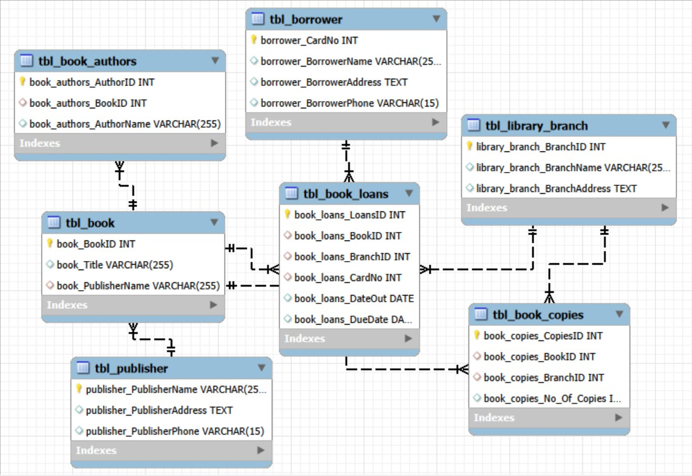
ER DIAGRAM

Slide 6

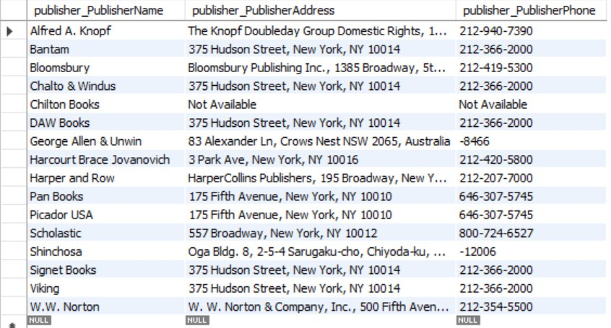
About Tables
Publisher Table

Slide 7

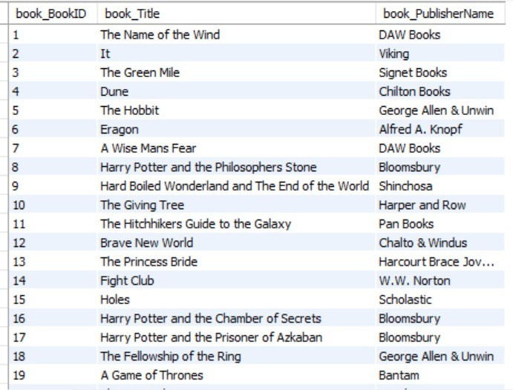
Book Author Table
Book Table

Slide 8

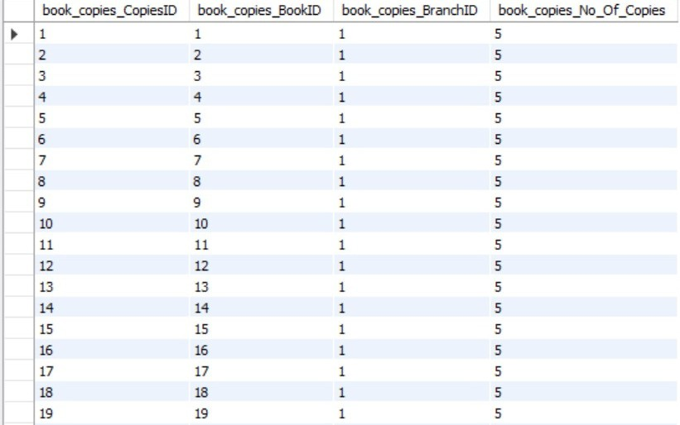
Book Copies Table

Slide 9
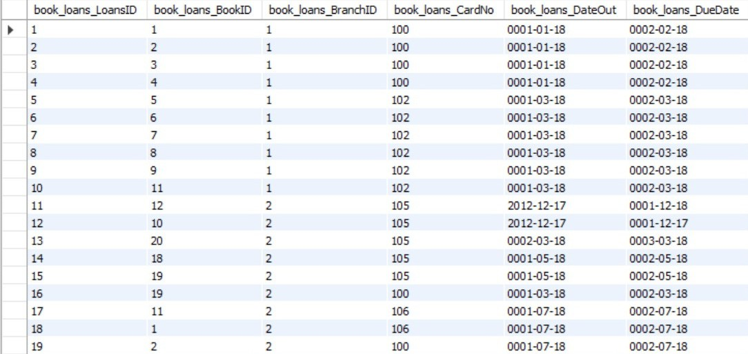
Bank Loans Table

Slide 10

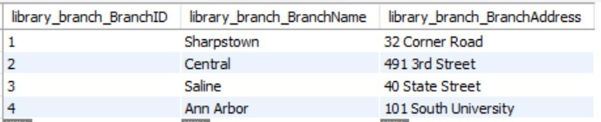
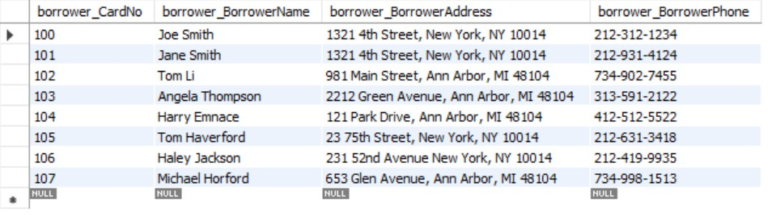
Library Branch Table
Borrowers Table

Slide 11
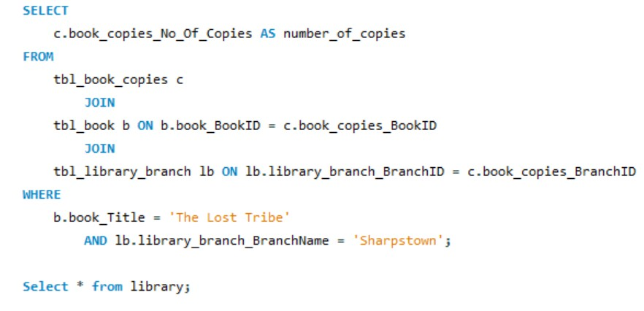
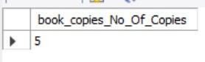
Data Analysis Questions
1. How many copies of the book titled "The Lost Tribe" are owned by the library branch whose
name is "Sharpstown"?
output

Slide 12
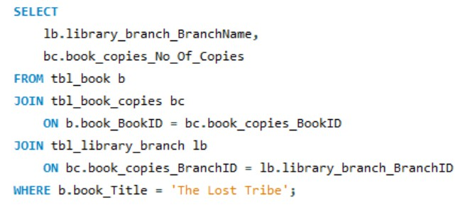
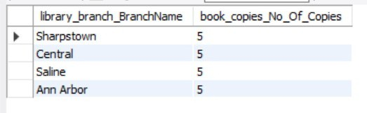
2. How many copies of the book titled "The Lost Tribe" are owned by each library
branch?
output

Slide 13
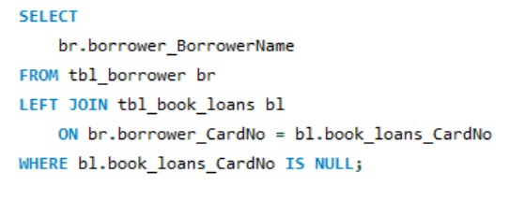
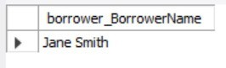
3. Retrieve the names of all borrowers who do not have any books
checked out.
output

Slide 14
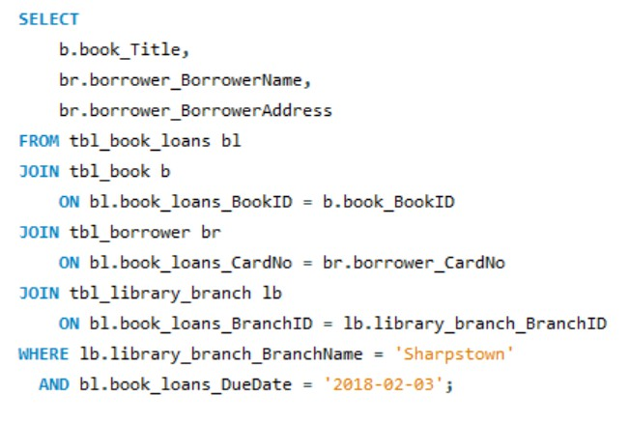
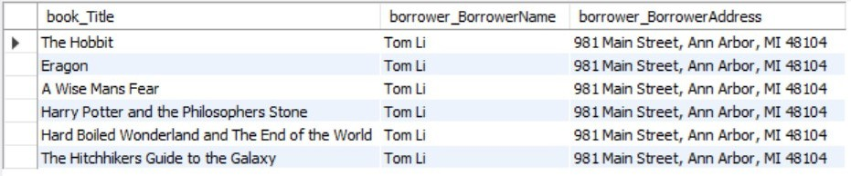
4. For each book that is loaned out from the "Sharpstown" branch and whose DueDate is 2/3/18, retrieve the book title, the borrower's name,
and the borrower's address.
output

Slide 15
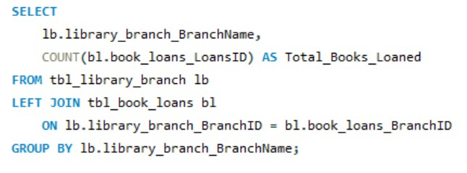
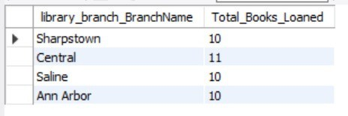
5. For each library branch, retrieve the branch name and the total number of books loaned out from that branch.
output

Slide 16

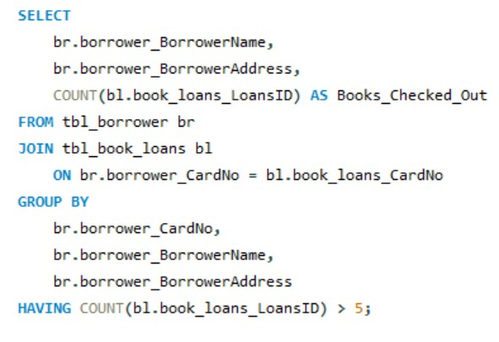
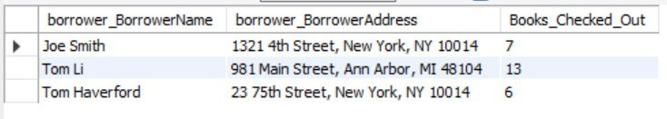
6. Retrieve the names, addresses, and number of books checked out for all borrowers who have more than five books checked out.
output

Slide 17
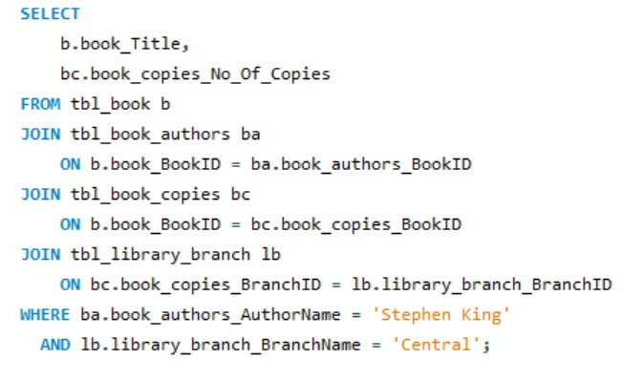
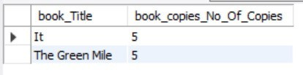
7. For each book authored by "Stephen King", retrieve the title and the number of copies owned by the library branch whose name is "Central".
output

Slide 18


Insights
Books and copies can be tracked across branches. Borrower activity and overdue loans are clearly visible. Popular books and authors show higher demand.
Branch-wise loan Performance Varies
Small Group of Borrowers Account for Most Loans
Recommendations
Balance Book Inventory Across Branches Increase Copies of High-Demand Books Improve Loan and Due-Date Monitoring Engage Inactive Borrowers

Slide 19
Conclusion
The Library Management System project successfully demonstrates the use of SQL and relational database concepts to manage library data efficiently. By designing normalized tables and establishing proper relationships, the system accurately tracks books, borrowers, branches, and loan activities. The project enables meaningful insights such as book availability, borrower behavior, and branch-wise loan performance. It highlights the importance of correct data mapping and well-structured queries in producing reliable results. Overall, this project provides a strong foundation for building scalable and data-driven library management solutions.

Slide 20


Slide 21

THANK YOU

